Slide 1
Object Oriented Programming ICT-1203
Dr. Jesmin Akhter
Associate Professor, IIT, JU

Slide 2
Java - URL Processing

Slide 3
URL stands for Uniform Resource Locator and represents a resource on the World Wide Web, such as a Web page or FTP directory.
We will learn how to write Java programs that communicate with a URL. A URL can be broken down into parts, as follows:
protocol://host:port/path?query#ref
Examples of protocols include HTTP, HTTPS, FTP, and File.
The path is also referred to as the filename, and the host is also called the authority.
The following is a URL to a Web page whose protocol is HTTP:
http://www.amrood.com/index.htm?language=en#j2se
Notice that this URL does not specify a port, in which case the default port for the protocol is used. With HTTP, the default port is 80.

Slide 4
A URL contains many information:
Protocol: In this case, http is the protocol.
Server name or IP Address: In this case, www.javatpoint.com is the server name.
Port Number: It is an optional attribute. If we write http//ww.javatpoint.com:80/sonoojaiswal/ , 80 is the port number. If port number is not mentioned in the URL, it returns -1.
File Name or directory name: In this case, index.jsp is the file name.

Slide 5
The java.net package contains two interesting classes:
The URL class and
The URL Connection class.

Slide 6
The java.net.URL class provides many methods. The important methods of URL class are given below.
Method | Description
public String getProtocol() | it returns the protocol of the URL.
public String getHost() | it returns the host name of the URL.
public String getPort() | it returns the Port Number of the URL.
public String getFile() | it returns the file name of the URL.
public URLConnection openConnection() | it returns the instance of URLConnection i.e. associated with this URL.

Slide 7
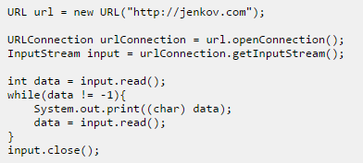
The URL class and the URLConnection classes can be used to create client connections to web servers (HTTP servers). Here is a simple code example:

Slide 8
Java URL Class
The java.net.URL class represents a URL and has complete set of methods to manipulate URL in Java.
//URLDemo.java
import java.io.*;
import java.net.*;
public class URLDemo{
public static void main(String[] args){
try{
URL url=new URL("http://www.javatpoint.com/java-tutorial");
System.out.println("Protocol: "+url.getProtocol());
System.out.println("Host Name: "+url.getHost());
System.out.println("Port Number: "+url.getPort());
System.out.println("File Name: "+url.getFile());
}catch(Exception e){System.out.println(e);}
}
}

Slide 9
Java URL Class
Output of previous program:
Protocol: http
Host Name: www.javatpoint.com
Port Number: -1
File Name: /java-tutorial

Slide 10
Java URL Class
Java’s URL class has several constructors; each can throw a MalformedURLException.
URL(String urlSpecifier)
throws MalformedURLException
The next three forms of the constructor allow you to break up the URL into its component parts:
URL(String protocolName, String hostName, int port, String path)
throws MalformedURLException
URL(String protocolName, String hostName, String path)
throws MalformedURLException
URL(URL urlObj, String urlSpecifier)
throws MalformedURLException

Slide 11
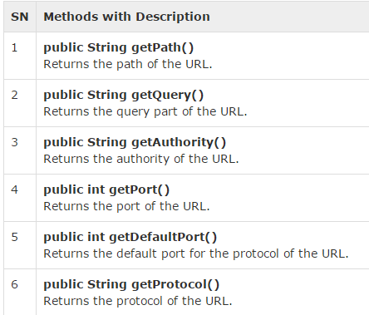
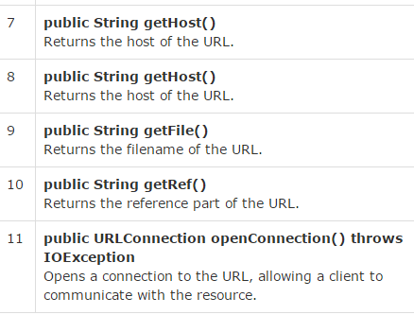
Java URL Class
The URL class contains many methods for accessing the various parts of the URL being represented.

Slide 12
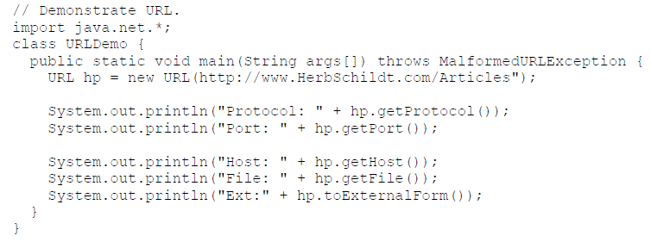
Java URL Class
The example creates a URL to HerbSchildt.com’s articles page and then examines its properties:

Slide 13
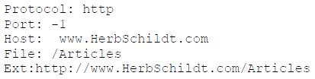
Java URL Class
When you run this, you will get the following output:

Slide 14
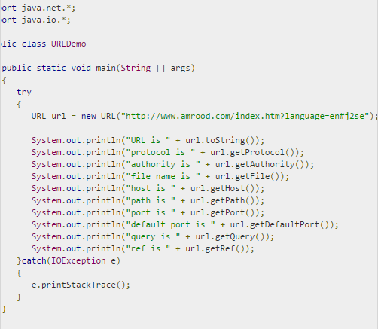
The following URLDemo program demonstrates the various parts of a URL. A URL is entered on the command line, and the URLDemo program outputs each part of the given URL.

Slide 15
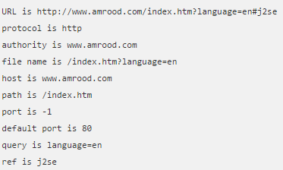
Java URL Class
Output of the previous program:

Slide 16
Java URLConnection class
The Java URLConnection class represents a communication link between the URL and the application. This class can be used to read and write data to the specified resource referred by the URL.
How to get the object of URLConnection class:
The openConnection() method of URL class returns the object of URLConnection class.
Syntax:
public URLConnection openConnection()throws IOException{}

Slide 17
URLConnections Class Methods
The openConnection() method returns a java.net.URLConnection, an abstract class whose subclasses represent the various types of URL connections.
For example:
If you connect to a URL whose protocol is HTTP, the openConnection() method returns an HttpURLConnection object.

Slide 18
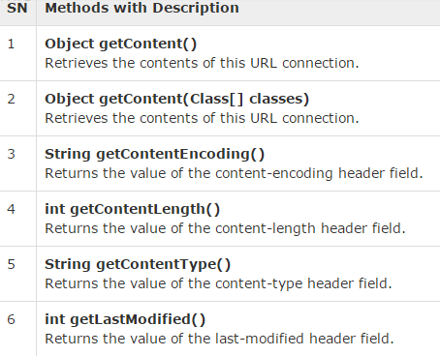
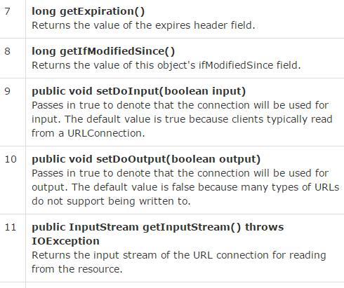
URLConnections Class Methods
The URLConnection class has many methods for setting or determining information about the connection:

Slide 19
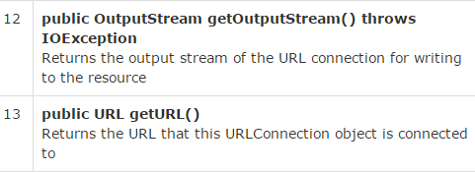
URLConnections Class Methods

Slide 20
Displaying source code of a webpage by URLConnecton class
The URLConnection class provides many methods, we can display all the data of a webpage by using the getInputStream() method. The getInputStream() method returns all the data of the specified URL in the stream that can be read and displayed.
Example: next slide

Slide 21
Displaying source code of a webpage by URLConnecton class
import java.io.*;
import java.net.*;
public class UR {
public static void main(String[] args){
try{
URL url=new URL("http://www.javatpoint.com/java-tutorial");
URLConnection urlcon=url.openConnection();
InputStream stream=urlcon.getInputStream();
int i;
while((i=stream.read())!=-1){
System.out.print((char)i);
}
}catch(Exception e){System.out.println(e);}
}
}

Slide 22
Output
<!DOCTYPE HTML PUBLIC "-//IETF//DTD HTML 2.0//EN">
<html><head>
<title>302 Found</title>
</head><body>
<h1>Found</h1>
<p>The document has moved <a href="https://www.javatpoint.com/java-tutorial">here</a>.</p>
</body></html>

Slide 23
Java HttpURLConnection class
The Java HttpURLConnection class is http specific URLConnection. It works for HTTP protocol only.
By the help of HttpURLConnection class, you can information of any HTTP URL such as header information, status code, response code etc.
The java.net.HttpURLConnection is subclass of URLConnection class.

Slide 24
Java HttpURLConnection class
How to get the object of HttpURLConnection class:
The openConnection() method of URL class returns the object of URLConnection class.
Syntax:
public URLConnection openConnection()throws IOException{}
You can typecast it to HttpURLConnection type as given below:
URL url=new URL("http://www.javatpoint.com/java-tutorial");
HttpURLConnection huc=(HttpURLConnection)url.openConnection();

Slide 25
Java HttpURLConnection class
import java.net.*;
public class UR{
public static void main(String[] args){
try{
URL url=new URL("http://www.javatpoint.com/java-tutorial");
HttpURLConnection huc=(HttpURLConnection)url.openConnection();
for(int i=1;i<=8;i++){
System.out.println(huc.getHeaderFieldKey(i)+" = "+huc.getHeaderField(i));
}
huc.disconnect();
}catch(Exception e){System.out.println(e);}
}
}

Slide 26
Java HttpURLConnecton Example
Output of previous program:
Date = Wed, 10 Dec 2014 19:31:14 GMT
Set-Cookie = JSESSIONID=D70B87DBB832820CACA5998C90939D48; Path=/
Content-Type = text/html
Cache-Control = max-age=2592000
Expires = Fri, 09 Jan 2015 19:31:14 GMT
Vary = Accept-Encoding,User-Agent
Connection = close Transfer-Encoding = chunked

Slide 27
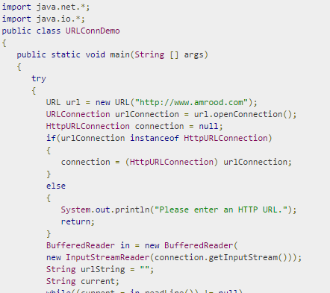
The following URLConnectionDemo program connects to a URL entered from the command line.

Slide 28
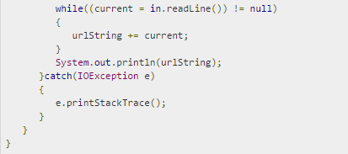

A sample run of the this program would produce the following result:

Slide 29
Thank you

